Slide 1

Serverless for the enterprise with Microsoft Azure Functions
[speaker]

Slide 2
Why serverless?

Slide 3
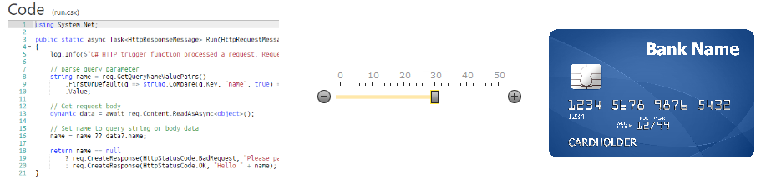
"Serverless Computing" doesn't really mean there's no server. Serverless means there's no server you need to worry about. That might sound like PaaS, but it's higher level that than.
Serverless Computing is like this - Your code, a slider bar, and your credit card.
You just have your function out there and it will scale as long as you can pay for it. It's as close to "cloudy" as The Cloud can get.
- Scott Hanselman http://www.hanselman.com/blog/WhatIsServerlessComputingExploringAzureFunctions.aspx

Slide 4
What is “serverless”
Abstraction of servers
Event-driven scale
Sub-second billing
Notes:
Abstraction of servers, infrastructure and configuration of operating system
Event-driven scale
Sub-second billing
Stateless

Slide 5
How is it different
Mono-lithic application
Inside client app
Complex framework
Loosely coupled components
Outside client app
Micro-functionality
Notes:
Mono-lithic application -> loosely coupled components
Events happening async outside client application
Build/use micro-functionality to react to a single event

Slide 6
Benefits of “serverless”
Micro-pricing
Ease of scale
Manage less
Notes:
“Pinnacle of PaaS compute”
Not just hardware “servers”, but software servers are also managed for you
Focus on business logic, not solving technical problems not core to business
Lower effort to get started makes it easier to experiment (bots, etc.)

Slide 7
How does this change how we think about building applications?
Instead of implementing a route inside of a Web Application server, I write a function.
Instead of writing large functional tests against a server, your functional tests look more like unit tests per function.
Instead of building and deploying servers, I deploy collections of Functions

Slide 8
General practices for serverless
Thick clients; thin & stateless backends
SPAs like Angular/React are your friend
Be sure to enable CORS ☺
Sync is nice, but Async is nicer
Async, queue based systems are more resilient
Read and internalize the reactive manifesto - http://www.reactivemanifesto.org/
While synchronous work will happen, minimize the work done in a sync function and kick off to a queue based async process (HTTP status code 202, not 201 ☺)
Live and die by the cloud
Like never before, develop on the cloud, test on the cloud, ship on the cloud
Not just FaaS, but use other serverless tech that best solves the problem (like Logic Apps)

Slide 9
Key benefits of Azure Functions

Slide 10



Azure Functions
Code
Azure Functions
Events + data
Process events with Serverless code.
BAM!!!
Make composing Cloud Apps insanely easy
Develop Functions in C#, Node.js, F#, Python, PHP, Batch and more
Easily schedule event-driven tasks across services
Expose Functions as HTTP API endpoints
Scale Functions based on customer demand
Easily integrate with Logic Apps

Slide 11
Azure Functions architecture
Built on top of App Service and WebJobs SDK
Code
Config
Language Runtime C#, Node.js, F#, PHP, etc.
WebJobs Script Runtime Azure Functions Host – Dynamic Compilation, Language abstractions, etc.
WebJobs Core
Programming model, common abstractions
WebJobs Extensions
Triggers, input and output bindings
App Service Dynamic Runtime Hosting, CI, Deployment Slots, Remote Debugging, etc.

Slide 12

Dual abstraction
Serverless compute abstracts away the compute
Bindings abstract away the services you interact with
Other Services
Business Logic
Serverless PaaS

Slide 13
Platform and scaling
App Service offers dedicated and dynamic tiers.
Dedicated is the existing App Service plan tiers
Basic, Standard, Premium
Pay based on # of reserved VMs
You’re responsible for scale
Dynamic
Pay on number of executions
Platform responsible for scale

Slide 14
Dynamic tier pricing
Pay per execution model - two meters, three units
Number of executions
Duration of execution x reserved memory

Slide 15
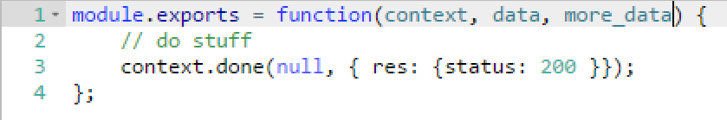
Functions programming concepts
Trigger
Input
Code
Output

Slide 16
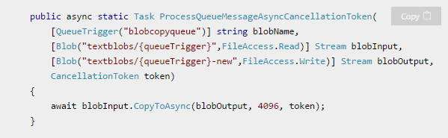
What is the “Functions” programming model?
Function as the unit of work
Functions are executed; they start and finish
Functions have inputs and outputs

Slide 17
Best practices for the “Functions” programming model
Functions should “do one thing”
Functions should be idempotent
Functions should finish as quickly as possible
1

Slide 18
Functions architecture patterns are often microservices patterns
Lots of smaller services
Independent deployment units
Inter-service versioning becomes very important
Use async messages between Functions, not sync http requests

Slide 19
Scaling and runtime best practices
E2E perf testing is still in fashion
Just because you’re not building services doesn’t mean there isn’t limits to the service
Each workload is a unique combination of resource consumption, it’s hard to know what the scale is ahead of time – working on providing some “ceilings”
Reduce, reuse, recycle (resources)
Functions in a Function App share memory
A singleton can be shared across many Functions – database connection pooling is possible, ditto for redis caches
Be careful of what you load – memory is averaged over your Functions
Get rid of data/objects you don’t need
Notes:
Working on open sourcing our load generator for customers to make use of

Slide 20
Scaling and runtime best practices (cont’d)
Disk is a network drive – shared across functions
Avoid disk access for perf critical work
Disk can be used between different instances
It’s just App Service
Kudu, etc. work fine, use them.
Use recommended guidance for App Service, where applicable

Slide 21
Putting it into action

Slide 22
Suggestions for getting started
For existing services, start small. Replace 1 API or background processing item.
Integration is a great place to introduce serverless, because it is often a new layer on top of old layers.
Have fun with it – build something that makes your life easier that wouldn’t normally justify buying a whole server for

Slide 23
Signs that a serverless pattern might be useful for a given scenario
Stateless → Scale
Not worth deploying a traditional backend
Workload is sporadic (very low & high scale)
“DevOps” favored over dedicated ops
Lots of different services involved that need “glue”

Slide 24
Applications
Example: Timer based processing
Eve
r
y 15 minutes
Find and clean invalid data
Clean table

Slide 25
Applications
Example: Azure service event processing
CSV
File added to
T
ransfo
r
m CSV to data
r
ows
P
ower BI
Blob Storage
Cha
r
t graphic

Slide 26
Applications
Example: SaaS event processing
Excel file saved
Mic
r
os
o
f
t Graph API analyzes content
C
r
eates new sheets
to OneDrive
with cha
r
ts

Slide 27
Applications
Example: Serverless Web Applications architectures
Loaded web page
C
r
eate ad based on user p
r
o
file
Completed page
calls
W
ebHook

Slide 28
Async background processing
Example: Serverless Mobile back ends
Photo taken and
Sto
r
es in blob storage
P
r
oduces scaled images
W
ebHook called

Slide 29
Applications
Example: Real-time stream processing
Millions
o
f devices feed
T
ransfo
r
m to structu
r
ed data
Sto
r
e data in
into St
r
eam Analytics
SQL Online

Slide 30
Applications
Example: Real-time bot messaging
...
?
Message sent
Co
r
tana Analytics answe
r
s questions
Chatbot sends
to Chatbot
r
esponse

Slide 31


Integration
Example: Invoice Processing
API Management
Logic App
Function
Post new invoice
Grab raw file
Convert to JSON
Store record
API layer
Fetch Invoice
Notes:
Chris

Slide 32

Get started and reach out!
Try Functions – https://functions.azure.com
Try App Service – https://tryappservice.azure.com

